Slide 1
M | u | l | t | i | d | i | m | e | n | s | i | o | n | a | l
A | r | r | a | y | s |  | i | n |  | C | + | + | :
T | h | e |  | s | y | d | e | v | s | : | : | a | r | r | a | y | n | d
c | l | a | s | s |  | t | e | m | p | l | a | t | e
Rhys Goldstein
Autodesk Research
rhys.goldstein@autodesk.com

Slide 2
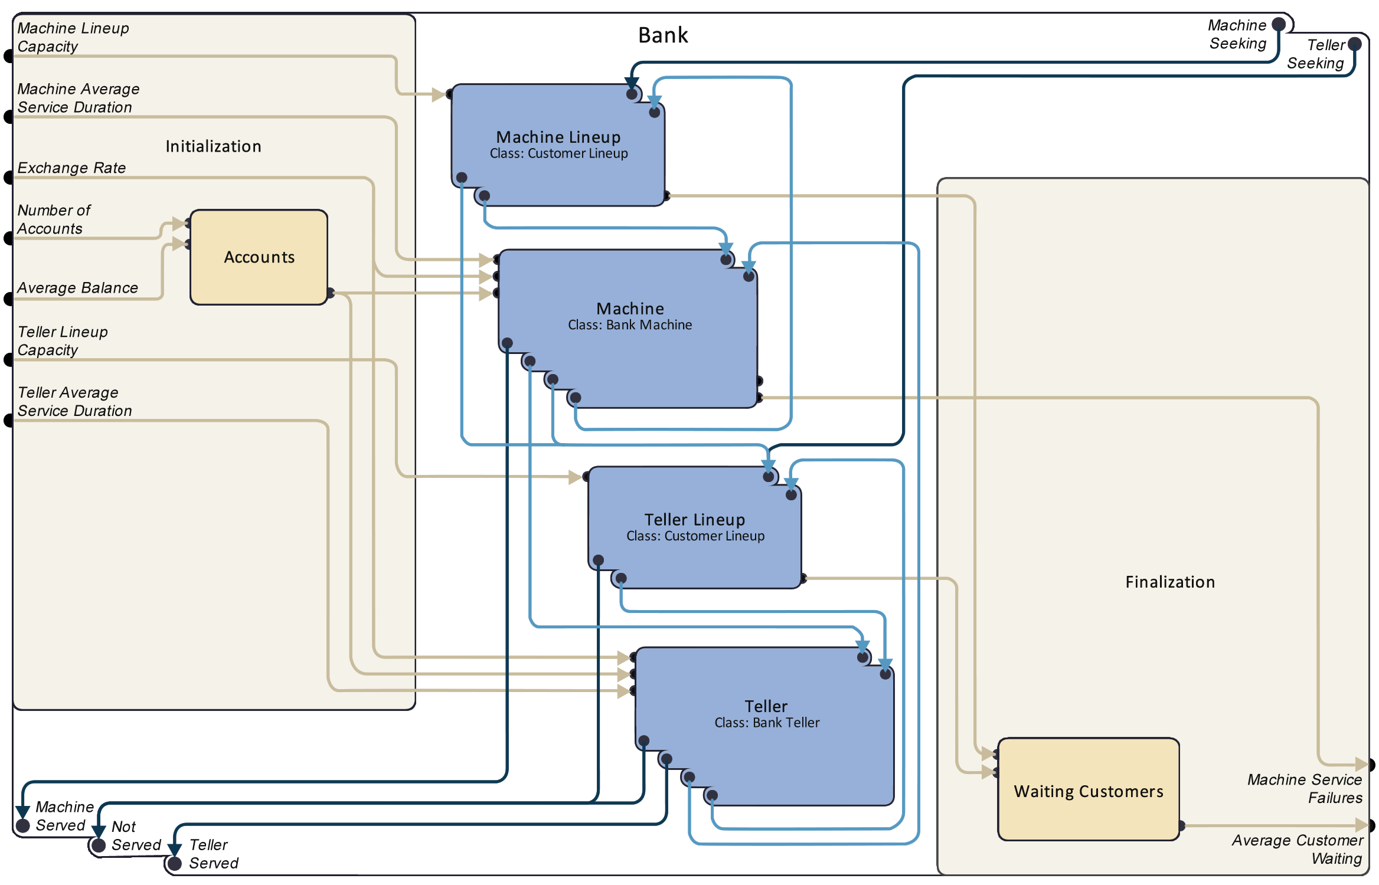
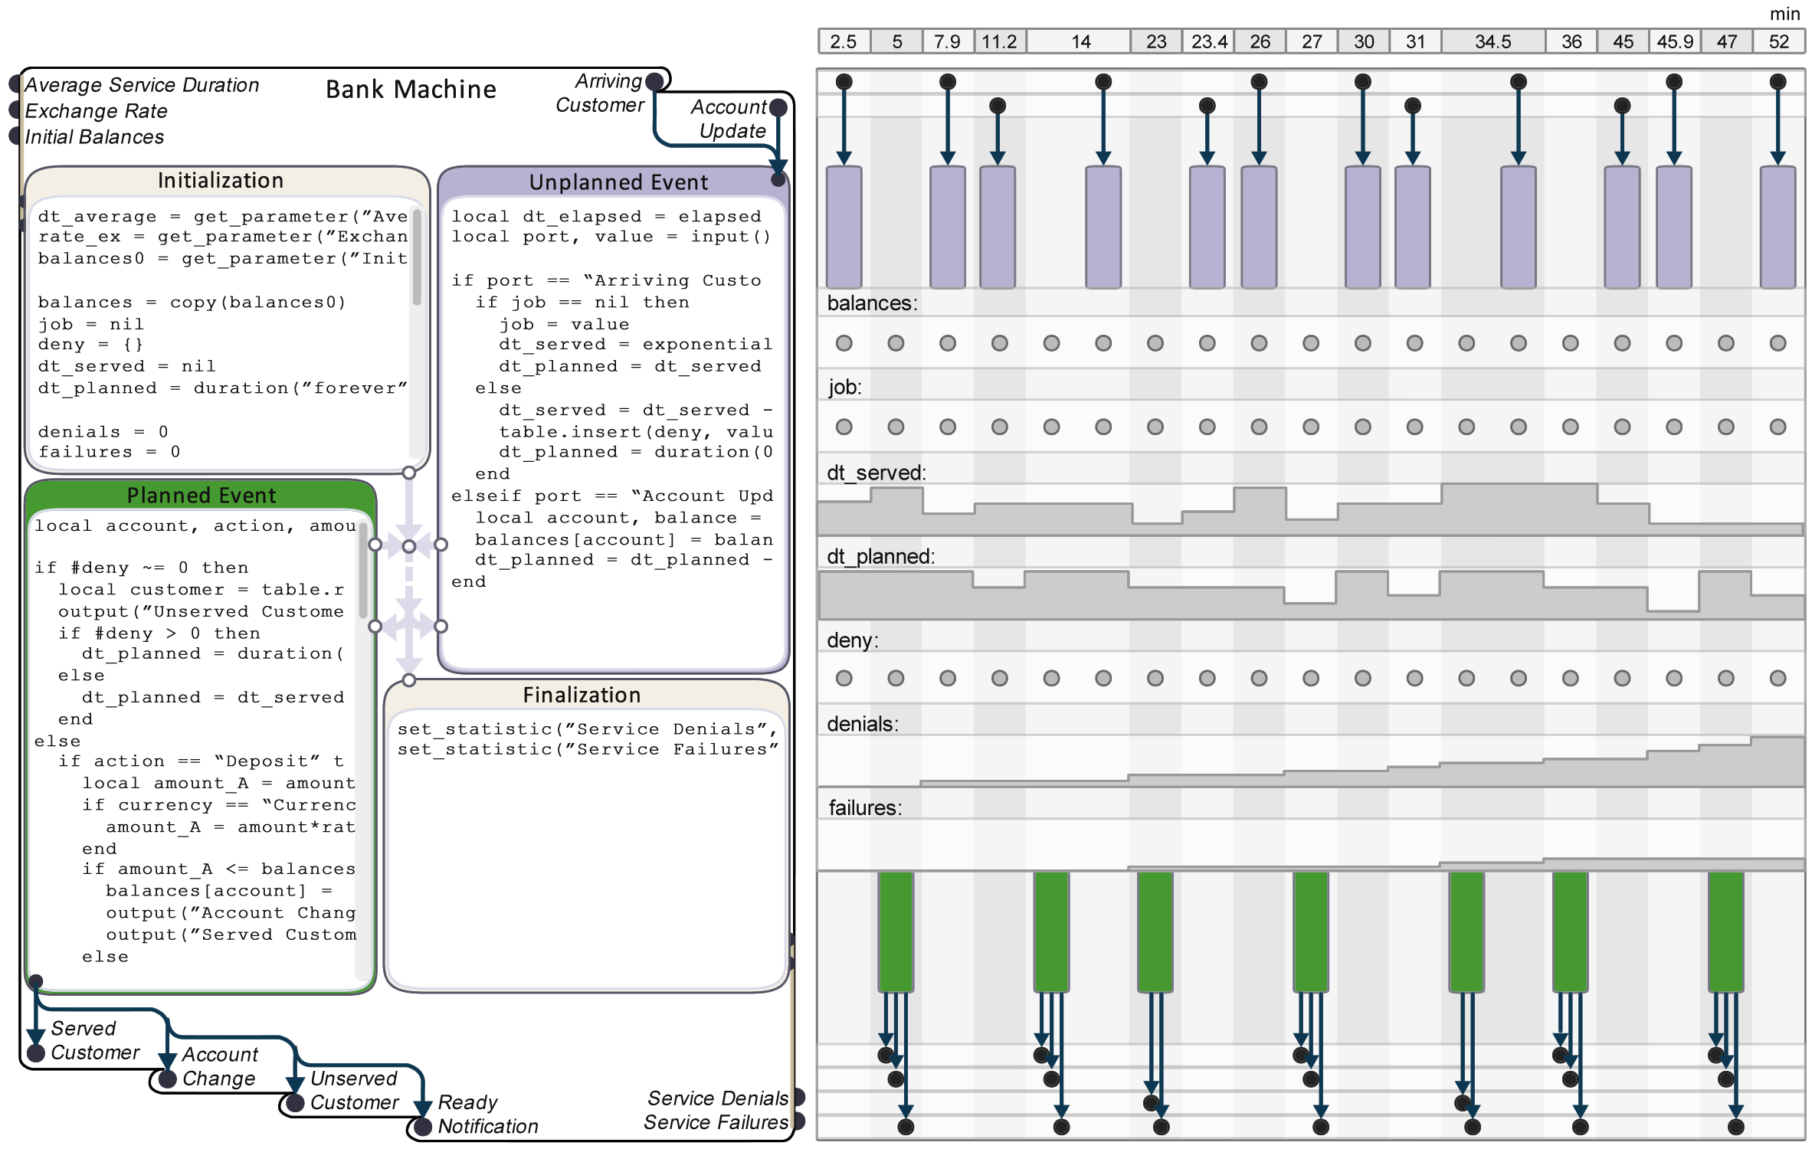
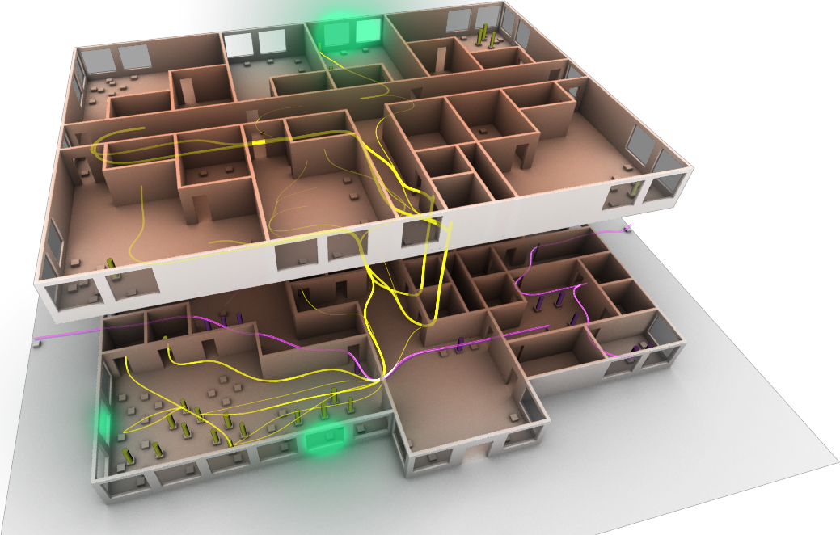
SyDEVS
Notes:
Although visual interfaces may be a more effective way to attract new users to DEVS, these interfaces will inevitably be influenced by the way the underlying theory is expressed.

Slide 3
numpy-like operations:
0 | 1 | 2
3 | 4 | 5
auto a = array2d<int64>({2, 3}, {0, 1, 2, 3, 4, 5});
auto b = array2d<int64>({2, 3}, {2, 1, 0, 2, 4, 6});
std::cout << a + b; // Prints "{{2, 2, 2}, {5, 8, 11}}".
std::cout << a + 5; // Prints "{{5, 6, 7}, {8, 9, 10}}".
std::cout << 5 - a; // Prints "{{5, 4, 3}, {2, 1, 0}}".
std::cout << a/2; // Prints "{{0, 0, 1}, {1, 2, 2}}".
std::cout << (a < b); // Prints "{{1, 0, 0}, {0, 0, 1}}".
std::cout << (a == b); // Prints "{{0, 1, 0}, {0, 1, 0}}".
std::cout << (a >= 1 && a <= 4); // Prints "{{0, 1, 1}, {1, 1, 0}}".
std::cout << all(a >= 0); // Prints "1".
std::cout << any(a == 7); // Prints "0".
a =
2 | 1 | 0
2 | 4 | 6
b =

Slide 4
numpy-like operations:
0 | 1 | 2
3 | 4 | 5
auto a = array2d<int64>({2, 3}, {0, 1, 2, 3, 4, 5});
auto b = array2d<int64>({2, 3}, {2, 1, 0, 2, 4, 6});
std::cout << a + b; // Prints "{{2, 2, 2}, {5, 8, 11}}".
std::cout << a + 5; // Prints "{{5, 6, 7}, {8, 9, 10}}".
std::cout << 5 - a; // Prints "{{5, 4, 3}, {2, 1, 0}}".
std::cout << a/2; // Prints "{{0, 0, 1}, {1, 2, 2}}".
std::cout << (a < b); // Prints "{{1, 0, 0}, {0, 0, 1}}".
std::cout << (a == b); // Prints "{{0, 1, 0}, {0, 1, 0}}".
std::cout << (a >= 1 && a <= 4); // Prints "{{0, 1, 1}, {1, 1, 0}}".
std::cout << all(a >= 0); // Prints "1".
std::cout << any(a == 7); // Prints "0".
a =
2 | 1 | 0
2 | 4 | 6
b =
2 | 2 | 2
5 | 8 | 11
a + b =

Slide 5
numpy-like operations:
0 | 1 | 2
3 | 4 | 5
auto a = array2d<int64>({2, 3}, {0, 1, 2, 3, 4, 5});
auto b = array2d<int64>({2, 3}, {2, 1, 0, 2, 4, 6});
std::cout << a + b; // Prints "{{2, 2, 2}, {5, 8, 11}}".
std::cout << a + 5; // Prints "{{5, 6, 7}, {8, 9, 10}}".
std::cout << 5 - a; // Prints "{{5, 4, 3}, {2, 1, 0}}".
std::cout << a/2; // Prints "{{0, 0, 1}, {1, 2, 2}}".
std::cout << (a < b); // Prints "{{1, 0, 0}, {0, 0, 1}}".
std::cout << (a == b); // Prints "{{0, 1, 0}, {0, 1, 0}}".
std::cout << (a >= 1 && a <= 4); // Prints "{{0, 1, 1}, {1, 1, 0}}".
std::cout << all(a >= 0); // Prints "1".
std::cout << any(a == 7); // Prints "0".
a =
2 | 1 | 0
2 | 4 | 6
b =
5 | 6 | 7
8 | 9 | 10
a + 5 =

Slide 6
numpy-like operations:
0 | 1 | 2
3 | 4 | 5
auto a = array2d<int64>({2, 3}, {0, 1, 2, 3, 4, 5});
auto b = array2d<int64>({2, 3}, {2, 1, 0, 2, 4, 6});
std::cout << a + b; // Prints "{{2, 2, 2}, {5, 8, 11}}".
std::cout << a + 5; // Prints "{{5, 6, 7}, {8, 9, 10}}".
std::cout << 5 - a; // Prints "{{5, 4, 3}, {2, 1, 0}}".
std::cout << a/2; // Prints "{{0, 0, 1}, {1, 2, 2}}".
std::cout << (a < b); // Prints "{{1, 0, 0}, {0, 0, 1}}".
std::cout << (a == b); // Prints "{{0, 1, 0}, {0, 1, 0}}".
std::cout << (a >= 1 && a <= 4); // Prints "{{0, 1, 1}, {1, 1, 0}}".
std::cout << all(a >= 0); // Prints "1".
std::cout << any(a == 7); // Prints "0".
a =
2 | 1 | 0
2 | 4 | 6
b =
5 | 4 | 3
2 | 1 | 0
a + 5 =

Slide 7
numpy-like operations:
0 | 1 | 2
3 | 4 | 5
auto a = array2d<int64>({2, 3}, {0, 1, 2, 3, 4, 5});
auto b = array2d<int64>({2, 3}, {2, 1, 0, 2, 4, 6});
std::cout << a + b; // Prints "{{2, 2, 2}, {5, 8, 11}}".
std::cout << a + 5; // Prints "{{5, 6, 7}, {8, 9, 10}}".
std::cout << 5 - a; // Prints "{{5, 4, 3}, {2, 1, 0}}".
std::cout << a/2; // Prints "{{0, 0, 1}, {1, 2, 2}}".
std::cout << (a < b); // Prints "{{1, 0, 0}, {0, 0, 1}}".
std::cout << (a == b); // Prints "{{0, 1, 0}, {0, 1, 0}}".
std::cout << (a >= 1 && a <= 4); // Prints "{{0, 1, 1}, {1, 1, 0}}".
std::cout << all(a >= 0); // Prints "1".
std::cout << any(a == 7); // Prints "0".
a =
2 | 1 | 0
2 | 4 | 6
b =
0 | 0 | 1
1 | 2 | 2
a/2 =

Slide 8
numpy-like operations:
0 | 1 | 2
3 | 4 | 5
auto a = array2d<int64>({2, 3}, {0, 1, 2, 3, 4, 5});
auto b = array2d<int64>({2, 3}, {2, 1, 0, 2, 4, 6});
std::cout << a + b; // Prints "{{2, 2, 2}, {5, 8, 11}}".
std::cout << a + 5; // Prints "{{5, 6, 7}, {8, 9, 10}}".
std::cout << 5 - a; // Prints "{{5, 4, 3}, {2, 1, 0}}".
std::cout << a/2; // Prints "{{0, 0, 1}, {1, 2, 2}}".
std::cout << (a < b); // Prints "{{1, 0, 0}, {0, 0, 1}}".
std::cout << (a == b); // Prints "{{0, 1, 0}, {0, 1, 0}}".
std::cout << (a >= 1 && a <= 4); // Prints "{{0, 1, 1}, {1, 1, 0}}".
std::cout << all(a >= 0); // Prints "1".
std::cout << any(a == 7); // Prints "0".
a =
2 | 1 | 0
2 | 4 | 6
b =
1 | 0 | 0
0 | 0 | 1
(a < b) =

Slide 9
numpy-like operations:
0 | 1 | 2
3 | 4 | 5
auto a = array2d<int64>({2, 3}, {0, 1, 2, 3, 4, 5});
auto b = array2d<int64>({2, 3}, {2, 1, 0, 2, 4, 6});
std::cout << a + b; // Prints "{{2, 2, 2}, {5, 8, 11}}".
std::cout << a + 5; // Prints "{{5, 6, 7}, {8, 9, 10}}".
std::cout << 5 - a; // Prints "{{5, 4, 3}, {2, 1, 0}}".
std::cout << a/2; // Prints "{{0, 0, 1}, {1, 2, 2}}".
std::cout << (a < b); // Prints "{{1, 0, 0}, {0, 0, 1}}".
std::cout << (a == b); // Prints "{{0, 1, 0}, {0, 1, 0}}".
std::cout << (a >= 1 && a <= 4); // Prints "{{0, 1, 1}, {1, 1, 0}}".
std::cout << all(a >= 0); // Prints "1".
std::cout << any(a == 7); // Prints "0".
a =
2 | 1 | 0
2 | 4 | 6
b =
0 | 1 | 0
0 | 1 | 0
(a == b) =

Slide 10
numpy-like operations:
0 | 1 | 2
3 | 4 | 5
auto a = array2d<int64>({2, 3}, {0, 1, 2, 3, 4, 5});
auto b = array2d<int64>({2, 3}, {2, 1, 0, 2, 4, 6});
std::cout << a + b; // Prints "{{2, 2, 2}, {5, 8, 11}}".
std::cout << a + 5; // Prints "{{5, 6, 7}, {8, 9, 10}}".
std::cout << 5 - a; // Prints "{{5, 4, 3}, {2, 1, 0}}".
std::cout << a/2; // Prints "{{0, 0, 1}, {1, 2, 2}}".
std::cout << (a < b); // Prints "{{1, 0, 0}, {0, 0, 1}}".
std::cout << (a == b); // Prints "{{0, 1, 0}, {0, 1, 0}}".
std::cout << (a >= 1 && a <= 4); // Prints "{{0, 1, 1}, {1, 1, 0}}".
std::cout << all(a >= 0); // Prints "1".
std::cout << any(a == 7); // Prints "0".
a =
2 | 1 | 0
2 | 4 | 6
b =
0 | 1 | 1
1 | 1 | 0
(a >= 1 && a <= 4) =

Slide 11
numpy-like operations:
0 | 1 | 2
3 | 4 | 5
auto a = array2d<int64>({2, 3}, {0, 1, 2, 3, 4, 5});
auto b = array2d<int64>({2, 3}, {2, 1, 0, 2, 4, 6});
std::cout << a + b; // Prints "{{2, 2, 2}, {5, 8, 11}}".
std::cout << a + 5; // Prints "{{5, 6, 7}, {8, 9, 10}}".
std::cout << 5 - a; // Prints "{{5, 4, 3}, {2, 1, 0}}".
std::cout << a/2; // Prints "{{0, 0, 1}, {1, 2, 2}}".
std::cout << (a < b); // Prints "{{1, 0, 0}, {0, 0, 1}}".
std::cout << (a == b); // Prints "{{0, 1, 0}, {0, 1, 0}}".
std::cout << (a >= 1 && a <= 4); // Prints "{{0, 1, 1}, {1, 1, 0}}".
std::cout << all(a >= 0); // Prints "1".
std::cout << any(a == 7); // Prints "0".
a =
2 | 1 | 0
2 | 4 | 6
b =
all(a >= 0) =
1

Slide 12
numpy-like operations:
0 | 1 | 2
3 | 4 | 5
auto a = array2d<int64>({2, 3}, {0, 1, 2, 3, 4, 5});
auto b = array2d<int64>({2, 3}, {2, 1, 0, 2, 4, 6});
std::cout << a + b; // Prints "{{2, 2, 2}, {5, 8, 11}}".
std::cout << a + 5; // Prints "{{5, 6, 7}, {8, 9, 10}}".
std::cout << 5 - a; // Prints "{{5, 4, 3}, {2, 1, 0}}".
std::cout << a/2; // Prints "{{0, 0, 1}, {1, 2, 2}}".
std::cout << (a < b); // Prints "{{1, 0, 0}, {0, 0, 1}}".
std::cout << (a == b); // Prints "{{0, 1, 0}, {0, 1, 0}}".
std::cout << (a >= 1 && a <= 4); // Prints "{{0, 1, 1}, {1, 1, 0}}".
std::cout << all(a >= 0); // Prints "1".
std::cout << any(a == 7); // Prints "0".
a =
2 | 1 | 0
2 | 4 | 6
b =
any(a == 7) =
0

Slide 13
numpy-like operations:
auto a = array2d<int64>({2, 3}, {0, 1, 2, 3, 4, 5});
auto b = array2d<int64>({2, 3}, {2, 1, 0, 2, 4, 6});
std::cout << a + b; // Prints "{{2, 2, 2}, {5, 8, 11}}".
std::cout << a + 5; // Prints "{{5, 6, 7}, {8, 9, 10}}".
std::cout << 5 - a; // Prints "{{5, 4, 3}, {2, 1, 0}}".
std::cout << a/2; // Prints "{{0, 0, 1}, {1, 2, 2}}".
std::cout << (a < b); // Prints "{{1, 0, 0}, {0, 0, 1}}".
std::cout << (a == b); // Prints "{{0, 1, 0}, {0, 1, 0}}".
std::cout << (a >= 1 && a <= 4); // Prints "{{0, 1, 1}, {1, 1, 0}}".
std::cout << all(a >= 0); // Prints "1".
std::cout << any(a == 7); // Prints "0".

Slide 14
auto a = array2d<int64>({2, 3}, {0, 1, 2, 3, 4, 5});
auto a = array2d<int64>({2, 3}, {0, 1, 2, 3, 4, 5});
auto b = array2d<int64>({2, 3}, {2, 1, 0, 2, 4, 6});
std::cout << a + b; // Prints "{{2, 2, 2}, {5, 8, 11}}".
std::cout << a + 5; // Prints "{{5, 6, 7}, {8, 9, 10}}".
std::cout << 5 - a; // Prints "{{5, 4, 3}, {2, 1, 0}}".
std::cout << a/2; // Prints "{{0, 0, 1}, {1, 2, 2}}".
std::cout << (a < b); // Prints "{{1, 0, 0}, {0, 0, 1}}".
std::cout << (a == b); // Prints "{{0, 1, 0}, {0, 1, 0}}".
std::cout << (a >= 1 && a <= 4); // Prints "{{0, 1, 1}, {1, 1, 0}}".
std::cout << all(a >= 0); // Prints "1".
std::cout << any(a == 7); // Prints "0".
sydevs::arraynd

Slide 15
auto a = array2d<int64>({2, 3}, {0, 1, 2, 3, 4, 5});

Slide 16
auto a = array2d<int64>({2, 3}, {0, 1, 2, 3, 4, 5});
namespace sydevs {
template<typename T, int64 ndims>
class arraynd : ...
{
...
};
template<typename T> using array1d = arraynd<T, 1>;
template<typename T> using array2d = arraynd<T, 2>;
template<typename T> using array3d = arraynd<T, 3>;
...
template<typename T> using array9d = arraynd<T, 9>;
} // namespace

Slide 17
auto a = array2d<int64>({2, 3}, {0, 1, 2, 3, 4, 5});
a =

Slide 18
auto a = array2d<int64>({2, 3}, {0, 1, 2, 3, 4, 5});
0 | 1 | 2
3 | 4 | 5
a =

Slide 19
auto arr = array3d<int64>({2, 3, 4}, [](const std::array<int64, 3>& indices) {
return 100*indices[0] + 10*indices[1] + indices[2];
});
std::cout << arr; // {{{ 0, 1, 2, 3 },
// { 10, 11, 12, 13 },
// { 20, 21, 22, 23 }},
// {{ 100, 101, 102, 103 },
// { 110, 111, 112, 113 },
// { 120, 121, 122, 123 }}}

Slide 20
auto arr = array3d<int64>({2, 3, 4}, [](const std::array<int64, 3>& indices) {
return 100*indices[0] + 10*indices[1] + indices[2];
});
std::cout << arr; // {{{ 0, 1, 2, 3 },
// { 10, 11, 12, 13 },
// { 20, 21, 22, 23 }},
// {{ 100, 101, 102, 103 },
// { 110, 111, 112, 113 },
// { 120, 121, 122, 123 }}}
std::cout << arr(1, 0, 3);
arr(1, 0, 3) = 7;

Slide 21
auto arr = array3d<int64>({2, 3, 4}, [](const std::array<int64, 3>& indices) {
return 100*indices[0] + 10*indices[1] + indices[2];
});
std::cout << arr; // {{{ 0, 1, 2, 3 },
// { 10, 11, 12, 13 },
// { 20, 21, 22, 23 }},
// {{ 100, 101, 102, 103 },
// { 110, 111, 112, 113 },
// { 120, 121, 122, 123 }}}
std::cout << arr[1][0][3]; // Inefficient!
arr[1][0][3] = 7; // Inefficient!

Slide 22
auto arr = array3d<int64>({2, 3, 4}, [](const std::array<int64, 3>& indices) {
return 100*indices[0] + 10*indices[1] + indices[2];
});
std::cout << arr; // {{{ 0, 1, 2, 3 },
// { 10, 11, 12, 13 },
// { 20, 21, 22, 23 }},
// {{ 100, 101, 102, 103 },
// { 110, 111, 112, 113 },
// { 120, 121, 122, 123 }}}
std::cout << arr[range()][1][range().start_at(1).stride_by(2)];
// {{ 11, 13 },
// { 111, 113 }}".

Slide 23
auto arr = array3d<int64>({2, 3, 4}, [](const std::array<int64, 3>& indices) {
return 100*indices[0] + 10*indices[1] + indices[2];
});
arr[range()][1][range().start_at(1).stride_by(2)].fill(7);
std::cout << arr; // {{{ 0, 1, 2, 3 },
// { 10, 7, 12, 7 },
// { 20, 21, 22, 23 }},
// {{ 100, 101, 102, 103 },
// { 110, 7, 112, 7 },
// { 120, 121, 122, 123 }}}

Slide 24
auto arr = array3d<int64>({2, 3, 4}, [](const std::array<int64, 3>& indices) {
return 100*indices[0] + 10*indices[1] + indices[2];
});
auto arr2 = arr[range()][1][range().start_at(1).stride_by(2)];
arr2.fill(7)
std::cout << arr; // {{{ 0, 1, 2, 3 },
// { 10, 7, 12, 7 },
// { 20, 21, 22, 23 }},
// {{ 100, 101, 102, 103 },
// { 110, 7, 112, 7 },
// { 120, 121, 122, 123 }}}

Slide 25
auto arr = array3d<int64>({2, 3, 4}, [](const std::array<int64, 3>& indices) {
return 100*indices[0] + 10*indices[1] + indices[2];
});
auto arr2 = arr[range()][1][range().start_at(1).stride_by(2)].copy();
arr2.fill(7)
std::cout << arr; // {{{ 0, 1, 2, 3 },
// { 10, 11, 12, 13 },
// { 20, 21, 22, 23 }},
// {{ 100, 101, 102, 103 },
// { 110, 111, 112, 113 },
// { 120, 121, 122, 123 }}}

Slide 26
try {
const auto arr = array2d<std::string>({2, 2}, {"A", "B", "C", "D"});
auto arr2 = arr[range()];
arr2(0, 0) = "E";
}
catch (const std::logic_error& e) {
std::cout << "ERROR: " << e.what() << std::endl;
}
// ERROR: Attempt to obtain a non-const reference to readonly multidimensional
// array data

Slide 27
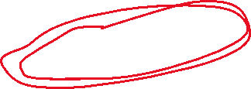
The sydevs::arraynd class template is open source.
Visit https://autodesk.github.io/sydevs/ or Google “SyDEVS”.
Also check out xtensor by QuantStack.
Visit https://xtensor.readthedocs.io/ or Google “xtensor”.
Rhys Goldstein
Autodesk Research
rhys.goldstein@autodesk.com

